Slide 1
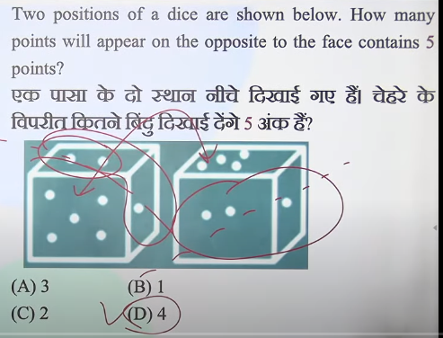
disrupts = disturb
breach = violating
recess time = free time
lockdown = march 24 2020
virus = 31 december 2019

Slide 2


Slide 3
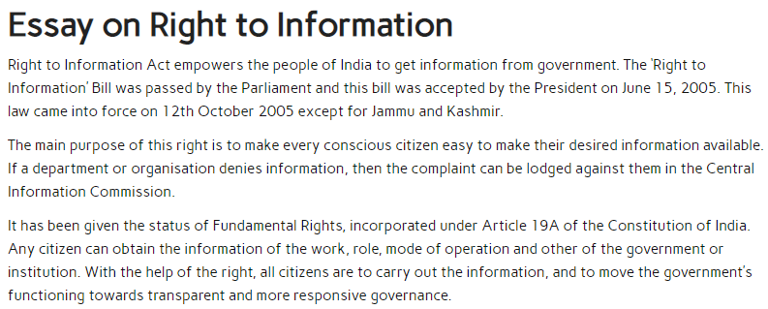
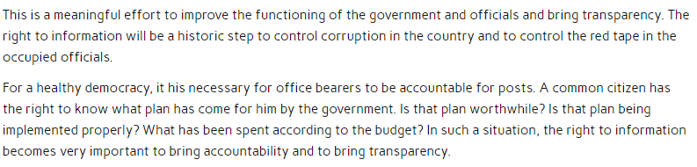

Slide 4
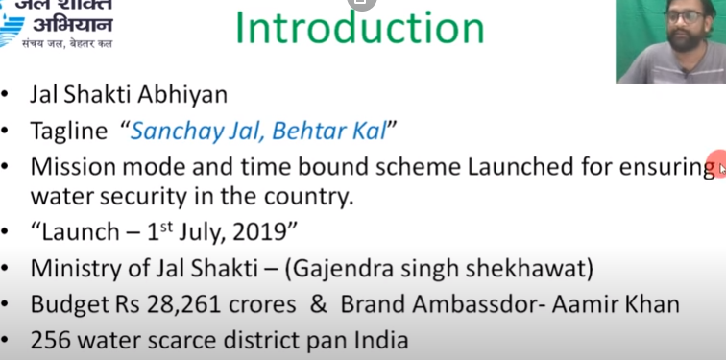

Slide 5
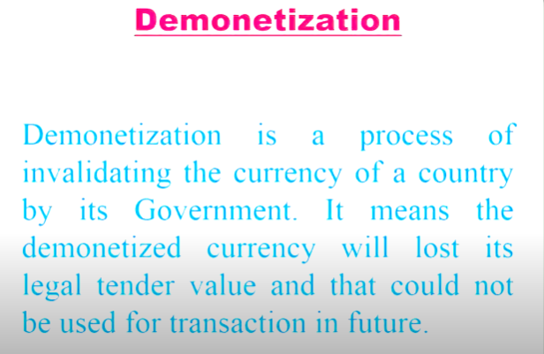
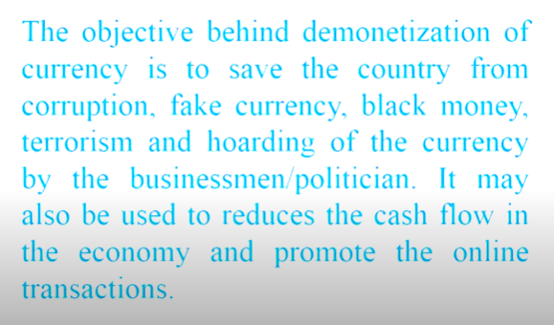
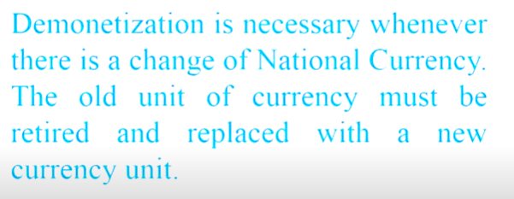

Slide 6
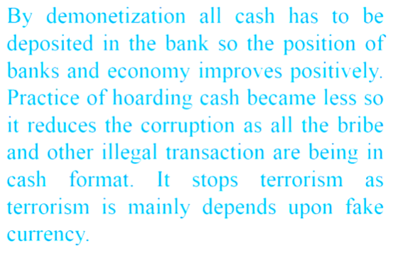
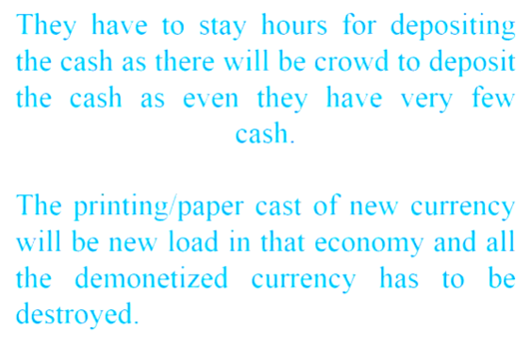
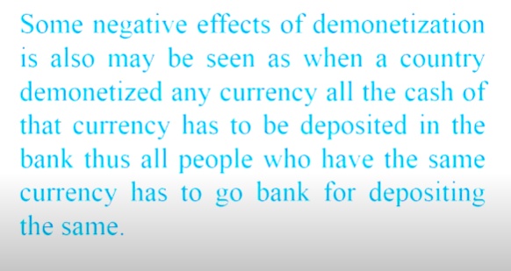
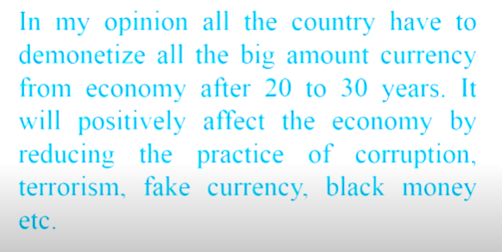

Slide 7
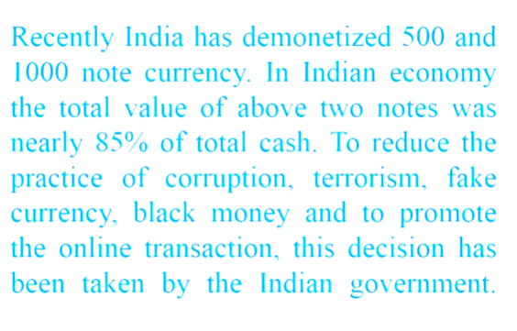
On November 8, 2016, Prime Minister Narendra Modi announced the demonetization of Rs. 500 and Rs. 1,000 currency notes. Furthermore, the government gave two months to deposit demonetized notes in any bank.
What is demonetization?
Demonetization is a process of stripping a currency unit of its status as a legal tender. In simple words, demonetized notes are no longer valid as legal currency. Usually, a new currency replaces the old currency unit/s.
The objectives and outcomes of the scheme in 2016 were:
To plug financing to terrorists.
To help unearth black money. The unearthed black money will expand the fiscal space of the government.
To help reduce interest rates in the banking system
To help formalize India’s informal economy. It will reduce the extent of cash transactions and help in the creation of a less-cash economy.
The government also offered several incentives to induce people to use digital transactions.

Slide 8
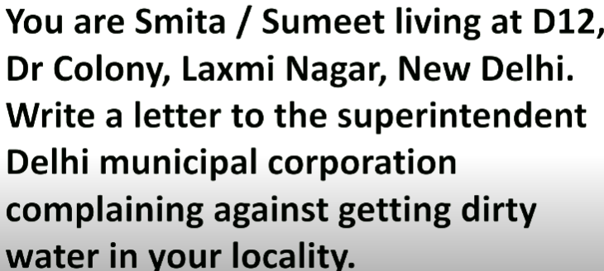
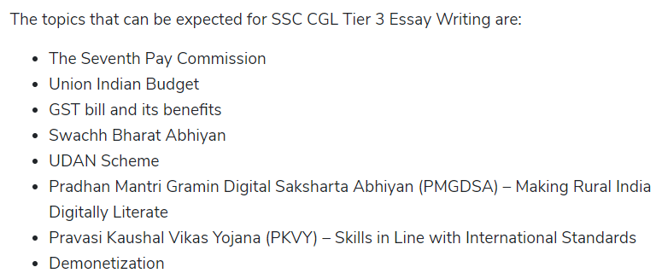

Slide 9
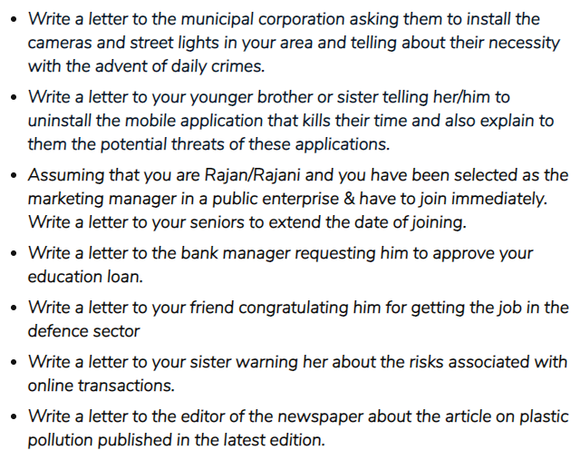

Slide 10
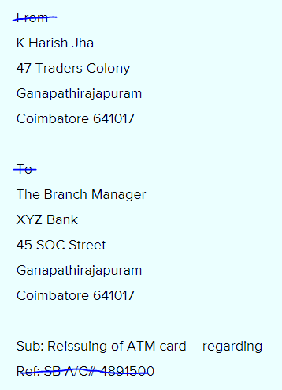
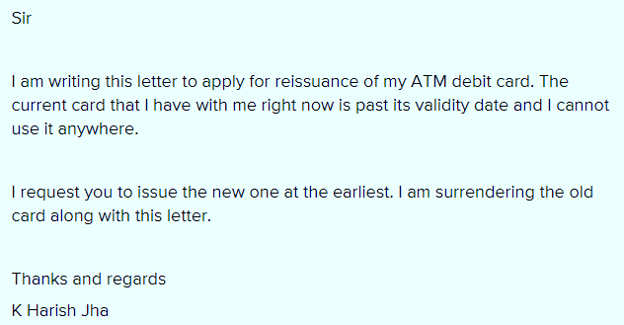

Slide 11
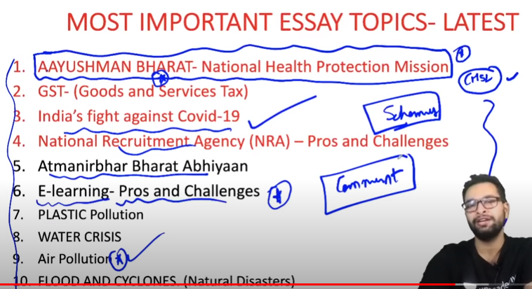
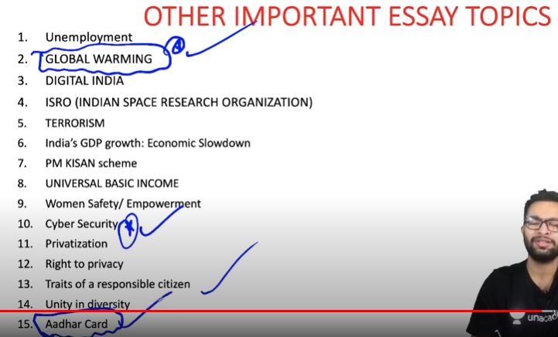

Slide 12
4.Pradhan Mantri Jan Dhan Yojna:
This scheme was launched to bring in Financial Inclusivity among the people of India.
This scheme was launched to bring in Financial Literacy and also help people to make use of the financial benefits which are already available with them.
Also, it aimed at providing banking services to the people who were not making use of it.
It covers a range of Financial Services like easy credit, remittances and insurances, etc
12.AMRUT Plan
Main purpose: Providing basic services (e.g. water supply, sewerage, urban transport) to households and build amenities in cities which will improve the quality of life for all, especially the poor and the disadvantaged is a national priority.
The purpose of Atal Mission for Rejuvenation and Urban Transformation (AMRUT) is to:
Ensure that every household has access to a tap with the assured supply of water and a sewerage connection.
Increase the amenity value of cities by developing greenery and well maintained open spaces (e.g. parks) and
Reduce pollution by switching to public transport or constructing facilities for non-motorized transport (e.g. walking and cycling). All these outcomes are valued by citizens, particularly women, and indicators and standards have been prescribed by the Ministry of Housing and Urban Affairs (MoHUA ) in the form of Service Level Benchmarks (SLBs)
5.Skill India Mission
Main purpose: The Mission has been developed to create convergence across sectors and States in terms of skill training activities. Further, to achieve the vision of 'Skilled India', the National Skill Development Mission would not only consolidate and coordinate skilling efforts, but also expedite decision making across sectors to achieve skilling at scale with speed and standards.
6. Make in India
Main purpose: PM Narendra Modi launched the 'Make in India' campaign to facilitate investment, foster innovation, enhance skill development, protect intellectual property & build best in class manufacturing infrastructure.
'Make in India' has identified 25 sectors in manufacturing, infrastructure and service activities and detailed information is being shared through interactive web-portal and professionally developed brochures. FDI has been opened up in Defence Production, Construction and Railway infrastructure in a big way.
7. Swachh Bharat Mission
Main purpose: On 2nd October 2014, Swachh Bharat Mission was launched throughout length and breadth of the country as a national movement. The campaign aims to achieve the vision of a 'Clean India' by 2nd October 2019. The Swachh Bharat Abhiyan is the most significant cleanliness campaign by the Government of India.

Slide 13
9.Atal Pension Yojna:
The scheme aims at providing a universal pension scheme for the people who are working in the unorganized sector, and most of their payments are not recorded. These people include gardeners, drivers, servants, etc.
Replacement of the Swavalamban Yojna
The main aim of the scheme is to secure the future of the people working in the unorganized sectors by making a pension provision for them
3.Pradhan Mantri Shram Yogi Maan-Dhan
This is also a scheme which is aimed at helping the workers of the unorganized sector like auto drivers, rag pickers, etc.
A minimum assured pension of Rs 3000 per month would be given to the subscriber of this scheme.
Also, if the subscriber dies, the spouse of the subscriber would receive 50% of the pension amount.
Also, the scheme can be transferred in the name of the nominee after if the subscriber dies before the age of 60.
Startup India
January 16, 2016 lanch
This government scheme was launched to support various entrepreneurs who come up with business ideas and are unable to convert those ideas into reality due to the lack of funds. The Government decided to help these entrepreneurs financially, as this would also ensure the creation of new jobs
8.Ujala Yojna
Main purpose: State run Energy Efficiency Services Ltd (EESL) has distributed over 30 crore light emitting diode (LED) bulbs across country under zero-subsidy Unnat Jyoti by Affordable LEDs for All (UJALA) scheme.
10. Prime Minister Jeevan Jyoti Bima Yojana
Main purpose: Pradhan Mantri Jeevan Jyoti Bima Yojana is a government-backed Life insurance scheme in India. Pradhan Mantri Jeevan Jyoti Bima Yojana is available to people between 18 and 50 years of age with bank accounts.
11. Pradhan Mantri Suraksha Bima Yojana
Main purpose: Pradhan Mantri Suraksha Bima Yojana is a government-backed accident insurance scheme in India. As of May 2016, only 20% of India's population has any kind of insurance, this scheme aims to increase the number.
12. Digital India Mission
Main purpose: The Digital India programme is a flagship programme of the Government of India with a vision to transform India into a digitally empowered society and knowledge economy.

Slide 14
13.UDAY
Main purpose: Ministry of Power, GoI launched Ujwal DISCOM Assurance Yojana (UDAY) which was approved by Union Cabinet on 5th November, 2015.
The scheme envisages:
Financial Turnaround
Operational improvement
Reduction of cost of generation of power
Development of Renewable Energy
Energy efficiency & conservation
14.Start-up india
Main purpose: Startup India is a flagship initiative of the Government of India, intended to catalyse startup culture and build a strong and inclusive ecosystem for innovation and entrepreneurship in India.

Slide 15
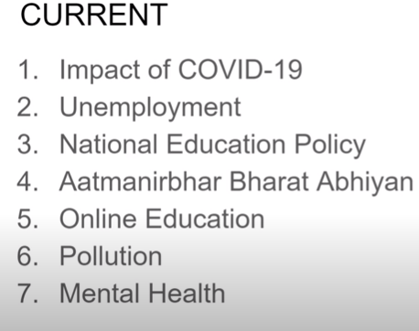

Slide 16

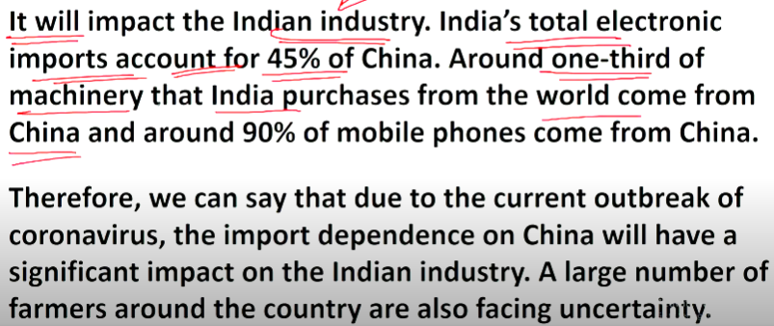

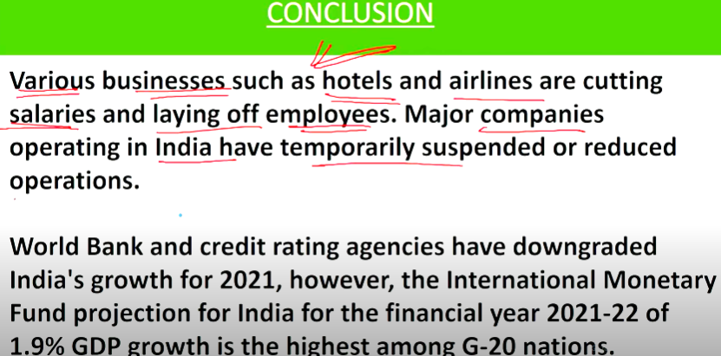
essay on impact of covid 19 on indian economy

Slide 17
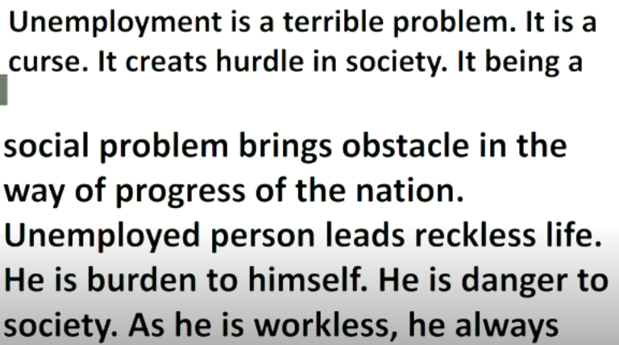
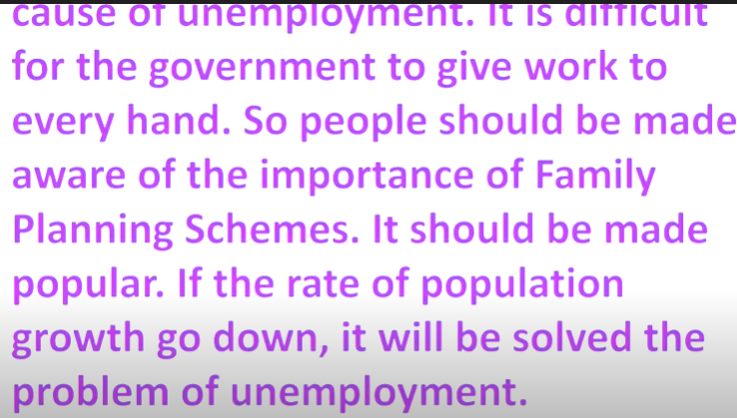
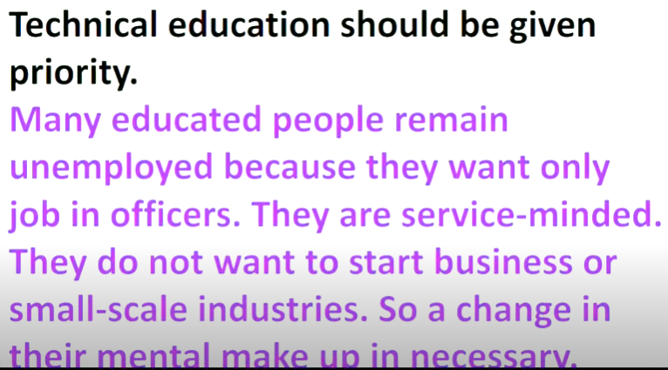
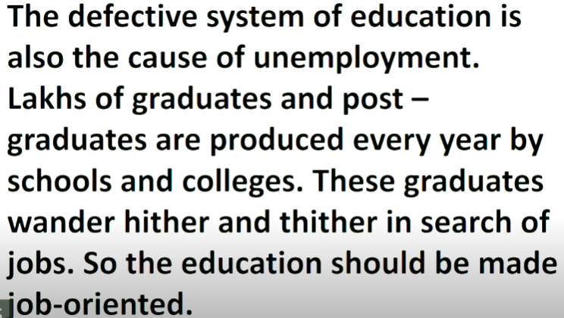
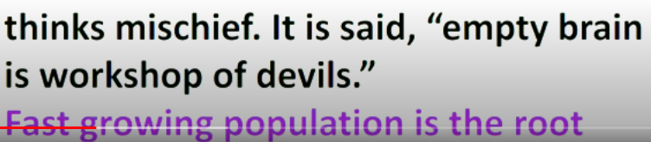

Slide 18
